Slide 1

The Fellowship of the Star Schema Transforming OLTP Data for PBI
Kristyna Ferris
Please grab some swag!
Fun Fact: this font is dyslexic friendly! Ask me how to use it for free after the session.
Notes:
Open-Dyslexic Font | dafont.com
Download the font from Open-Dyslexic Font | dafont.com
Extract the files
Go to computer settings > personalization > fonts and drop in the files
Navigate to Power Point Master Slide
Change the font to use Open Dyslexic for the headers and body
Done!

Slide 2






SQL Saturday 2025
Sponsors

Slide 3

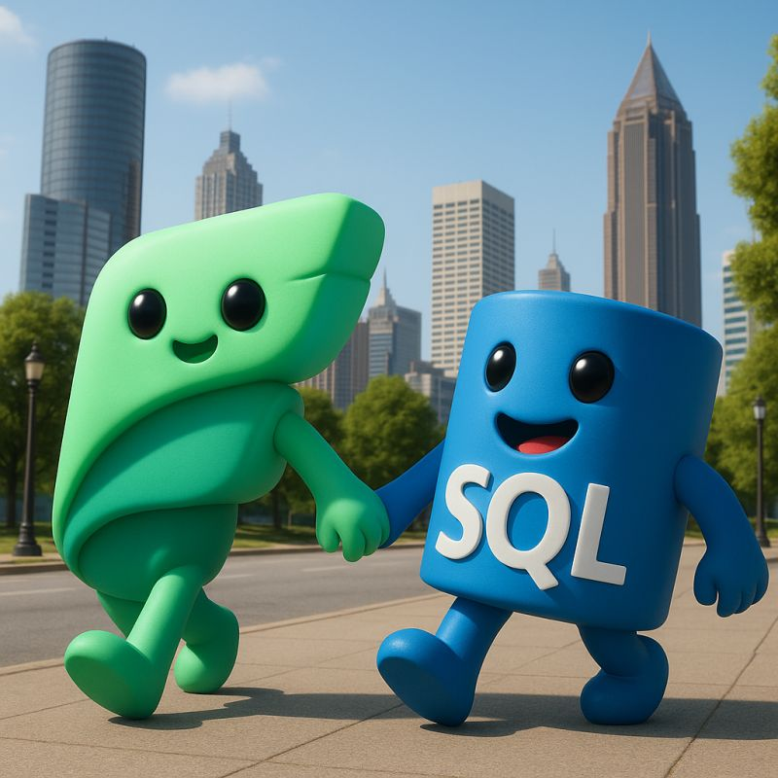
Microsoft Fabric and Oregon Data (SQL Server) User Groups are teaming up in 2026!
Look for combined, in-person & hybrid meetings announced by both groups
Register on Meetup to join us

Slide 4

Get Fabric Certified by Dec 31!
Free & discounted exam vouchers & training events ...but they are going fast!
DP-600 & DP-700 online study groups hosted live by our local user groups
Information: community.fabric.microsoft.com
community.fabric.microsoft.com/t5/Power-BI-Community-Blog/Fabric-Data-Days-Get-Certified

Slide 5

Microsoft Fabric and SQL Server teaming up on the big stage!
Register here

Slide 6

About Me ~ Kristyna Ferris
Microsoft MVP, Data Platform & Fabric Solution Architect, P3 Adaptive Lexington Data Tech Group co-organizer DataOnWheels Author
Blog
https://dataonwheels.wordpress.com/ LinkedIn
https://www.linkedin.com/in/kristyna-ferris-dataonwheels/
Twitter & Bluesky
@data_dragoness

Slide 7

A Quiet Start in the Shire - OLTP Origins
Many separate, highly specialized tables.
Day-to-day operations
Used by front-line workers and applications
Goal is transaction speed
Real-time data refreshness
Examples: order entry, banking, POS

Slide 8
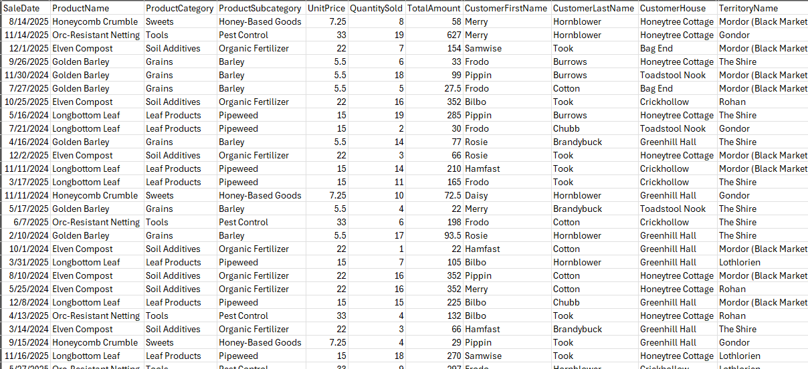
Sample OLTP

Slide 9

Arriving in Gondor – OLAP Citadel of Insight
Fewer, Organized Facts and Dimensions
Business analysis & reporting
Used by analysts, executives, & Power BI
Goal is query & aggregation speed
Data refreshed periodic (hourly/daily)
Examples: forecasting, sales analysis, reporting

Slide 10
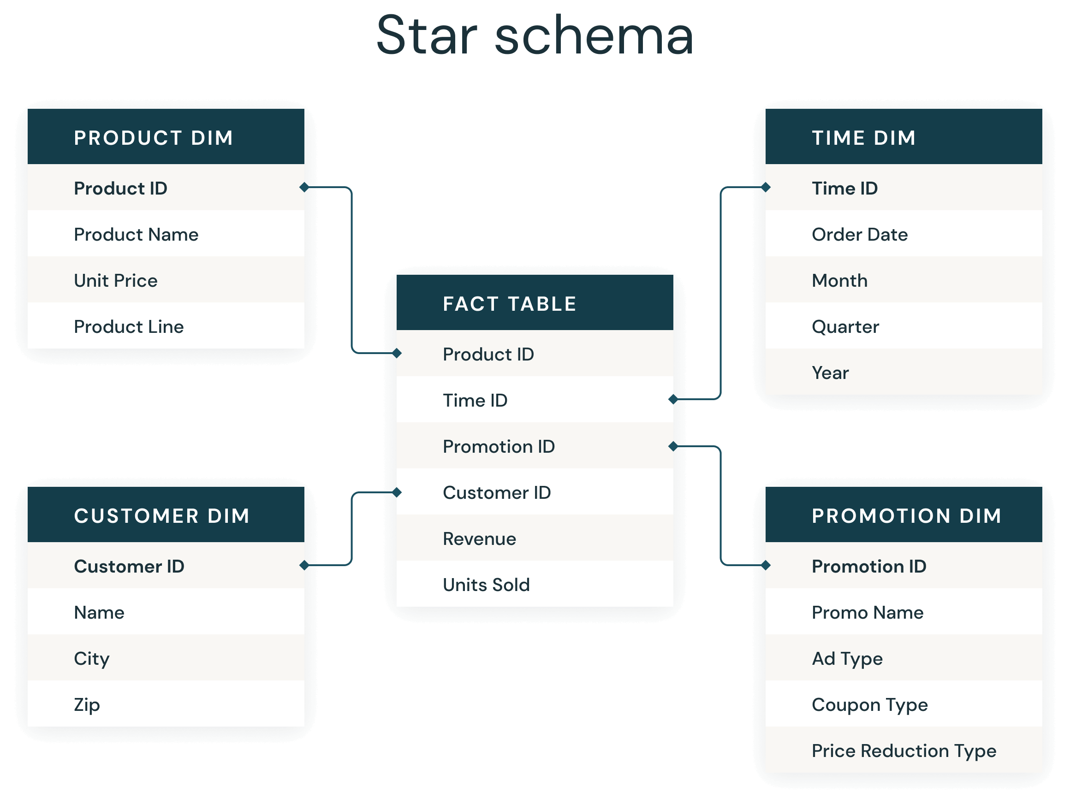
Sample OLAP

Slide 11

Demo Time!

Slide 12
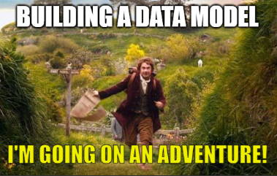
Journey to OLAP - Following the Star (Schema)
Star Schema is a proven table design for analytics.
Consists of a central fact table surrounded by related dimensions that slice and dice the facts
Fact tables = measurable data (sales, revenue, inventory, etc.)
Dimension tables = descriptive context (customer, product, date)
Optimized for Power BI and the Vertipaq engine
Supports powerful reporting scenarios like slicers, hierarchies, and time intelligence

Slide 13

The Council of Stakeholders – Defining the Quest
How do we get there?
Only by knowing what must be answered can the journey to insight begin.
Notes:
Pull out the bus matrix!

Slide 14
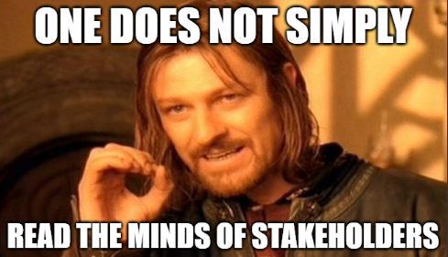
The Council of Stakeholders – Defining the Quest
What decisions are being made with this data?
What KPIs or metrics are most important to track?
What is the “make more money” question to answer?
What grain and scope of the data is needed?
Who will use this report and how do they need to slice this data?
What dimensions provide context for these metrics?
Where does the data currently live?
Are there data quality issues we need to resolve?
How frequently do we need to answer these questions?
Notes:
Pull out the bus matrix!

Slide 15
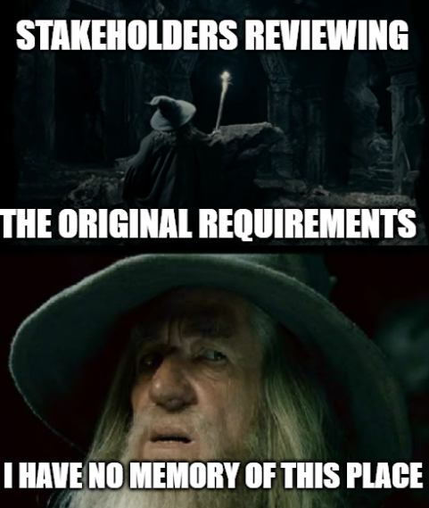
The Council of Stakeholders – Defining the Quest
Pro Tip
Write the answers to these questions down and email them to stakeholders.
This will hold them accountable to what the original goal of the report was.
Even better, put the answers on a hidden page of the report so the purpose of the report can never be forgotten.
Notes:
Pull out the bus matrix!

Slide 16

Mapping the Star Schema – Bus Matrix
Focus on measurable, event-based processes.
May result in the need for multiple reports and highlight missing data.
Dimensions → Business Process / Facts ↓ | Date | Product | Customer | Territory | Store
Sales
Inventory
Returns
Notes:
Benefits: Clarifies Scope: Stakeholders see what data is needed and where it overlaps.
Encourages Reuse: Promotes conformed dimensions—single definitions reused across processes.
Supports Iteration: You can build out your data warehouse in increments.
Bridges Tech & Business: Translates messy system tables into understandable business concepts.
Facilitates Power BI Modeling: Leads to semantic models that support consistent slicing/filtering.
Don’t be afraid to include data that doesn’t exist for now.

Slide 17
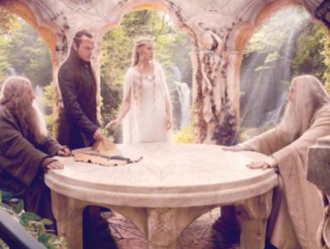
Guidance from the White Council - Best Practices (1/2)
Create an integer key for dimensions if one does not exist.
A column should be exposed in the model once and only once (excluding keys)
Customer Name should only live in the customer dimension, and not in any of the fact tables.
Columns should have unique and descriptive names
“Name” in both the Product and Customer dimensions is not helpful. Be specific.
Notes:
Part 1

Slide 18

Guidance from the White Council - Best Practices (2/2)
Use friendly names for columns. Spaces are okay in Power BI!
If a column is not needed for the report, do not import it.
Each dimension should have one row per “something”
Nearly all relationships should be 1 (dim) to many (fact)
Don’t relate two fact tables to each other
Roche’s Maxim – transform your data as far upstream as possible and as downstream as necessary
Notes:
Part 2

Slide 19
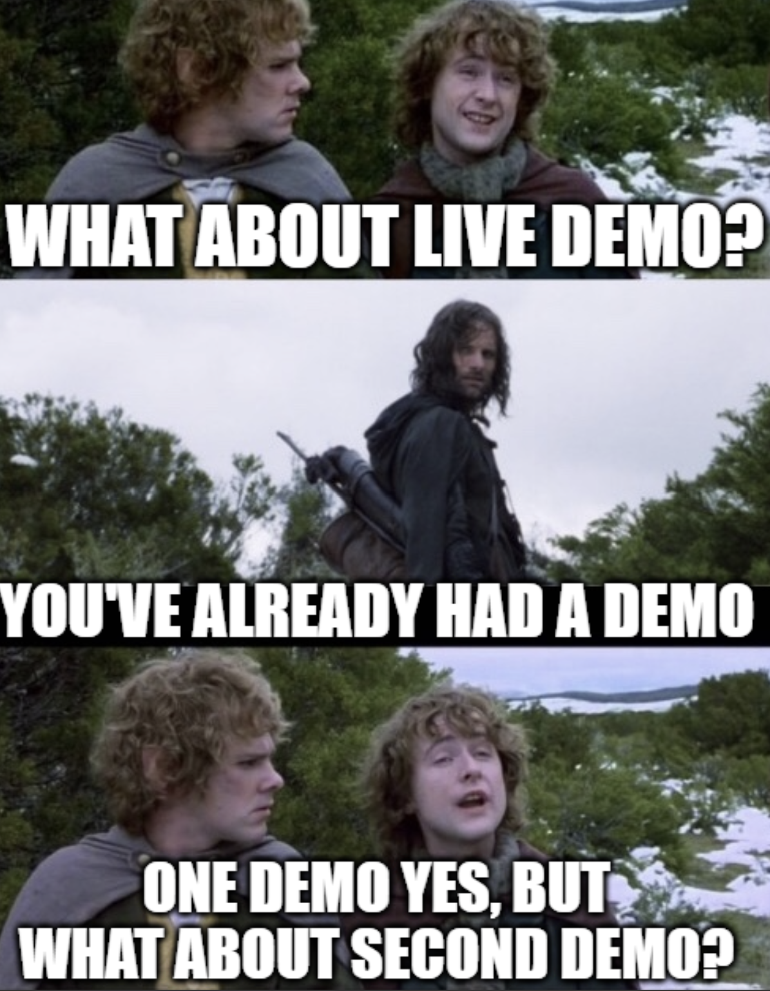
Demo Time!

Slide 20

Light the Beacons!
Trusted Allies
Guy in a Cube
Kimball Group
Story BI training (hands-on course)
Pragmatic Works
Local user groups
Stalk the speaker list at conferences, they usually have other resources.
Additional Topics to Explore
Slowly changing dimension type 2
Measures versus columns
Vertipaq engine optimization
Cardinality
Creating a date table
Notes:
Article & Design Tips at Kimball Group https://www.kimballgroup.com/category/articles-design-tips/ for free articles covering 20 years.
Dimensional Modeling in Fabric Warehouse (Microsoft Learn) https://learn.microsoft.com/en-us/fabric/data-warehouse/dimensional-modeling-overview
Why Power BI Loves a Star Schema: https://www.youtube.com/watch?v=vZndrBBPiQc
https://learn.microsoft.com/en-us/power-bi/guidance/star-schema

Slide 21

Don’t forget to connect, thanks for listening!
https://dataonwheels.wordpress.com/
kristyna@dataonwheels.com
@data_dragoness
GitHub

